Slide 2
Hansken extraction plugins
Walkthrough

Slide 3
Introduction
👨‍🏫 My name: remco
🐘 I am part of the Hansken development team
👨‍🚀 One of the main code contributors to the Extraction Plugin SDK
👨‍🔧 I am a software engineer
⚠️ not a
case investigator
authority on digital forensics
…

Slide 4

Introduction

Slide 5
Our fictional case
🕵️ We are investigating a case
🕒 Our suspect mentions that he/she was not at home and was not using his/her phone at a given time. Is that True?
📱 Evidence item: iPhone 15
Imaginary & creative solution:
🔌Find out when the phone is charging, and at what rate?
🔋 Find out when is the phone discharging, how fast is the phone discharging?
📈 Can we use the charging/discharging rate to prove our hypothesis?
So…
How can we know this?
And if we know this, how can we add this knowledge to Hansken?

Slide 6

Our fictional case: background research
Iphone file: knowledgeC.db
For this walkthrough: we will only focus on battery events!
Background reading:
https://www.doubleblak.com/knowledgec2
http://www.mac4n6.com/blog/2018/8/5/knowledge-is-power-using-the-knowledgecdb-database-on-macos-and-ios-to-determine-precise-user-and-application-usage
KnowledgeC.db is a SQLite file on recent iOS versions that tracks lots of different activity on the device ranging from Battery Level and Bluetooth connections to which speaker is in use and what it is playing at any given time (…) The database is located at /private/var/mobile/Library/CoreDuet/Knowledge/knowledgeC.db and is made up of 12 tables.

Slide 7
Talking points for today
(3 min) Our fictional case…
(2 min) Extracting knowledgeC.db in Hansken
(3 min) Extraction plugin concepts
(5 min) Write logic: parse knowledgeC.db and transform to Hansken types
(5 min) Extraction plugin template
(5 min) Add logic to plugin
(5 min) Run with Hansken.py
(5 min) Run the plugin during an extraction
(3 min) Add tests to our code
(3 min) Wrap up and questions

Slide 8
Talking points for today
(3 min) Our fictional case…
(2 min) Extract knowledgeC.db in Hansken
(3 min) Extraction plugin concepts
(5 min) Write logic: parse knowledgeC.db and transform to Hansken types
(5 min) Extraction plugin template
(5 min) Add logic to plugin
(5 min) Run with Hansken.py
(5 min) Run the plugin during an extraction
(3 min) Add tests to our code
(3 min) Wrap up and questions

Slide 9
Talking points for today
(3 min) Our fictional case…
(2 min) Extract knowledgeC.db in Hansken
(3 min) Extraction plugin concepts
(5 min) Write logic: parse knowledgeC.db and transform to Hansken types
(5 min) Extraction plugin template
(5 min) Add logic to plugin
(5 min) Run with Hansken.py
(5 min) Run the plugin during an extraction
(3 min) Add tests to our code
(3 min) Wrap up and questions

Slide 10
Extraction plugin concepts
Hansken.py
Standalone scripts
Interfaces over REST
Relatively slow ←
Easy to run
Manual invocation
Great for visualisations and analysis
Extraction Plugins
Installed scripts Runs distributed inside Hansken → Relatively fast
Small learning curve
Automatic invocation on all cases
Great for ‘forensic formats’ processing and individual trace enrichment
Extraction Plugins can run as Hansken.py scripts

Slide 11
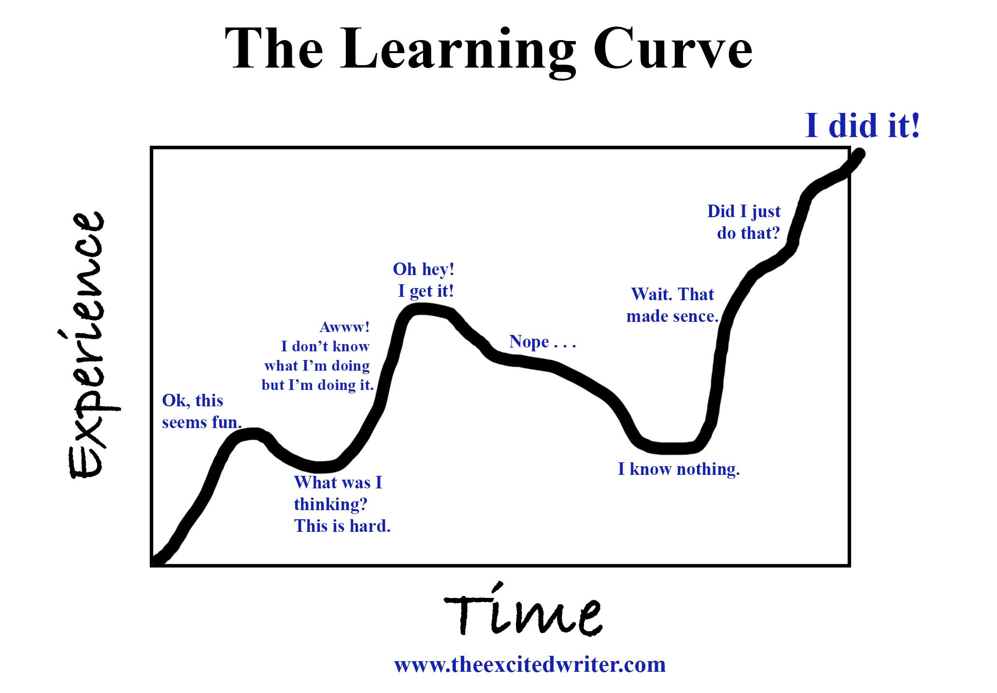

Slide 12
Extraction plugin concepts
Extraction plugin Software Development Kit (SDK):
Java API and tooling, to be able to write an extraction plugin with the Java programming language
Python API and tooling, to be able to write an extraction plugin with Python programming language
Test framework, to be able to test extraction plugins before they are used production
Documentation
Examples (Github)
Community: Extraction plugins made by the community on Gitlab

Slide 13
Talking points for today
(3 min) Our fictional case…
(2 min) Extract knowledgeC.db in Hansken
(3 min) Extraction plugin concepts
(5 min) Write logic: parse knowledgeC.db and transform to Hansken types
(5 min) Extraction plugin template
(5 min) Add logic to plugin
(5 min) Run with Hansken.py
(5 min) Run the plugin during an extraction
(3 min) Add tests to our code
(3 min) Wrap up and questions

Slide 14
Write logic: parse knowledgeC.db and transform to Hansken types
Steps
Determine how to store battery events in Hansken (trace model)
Write scripts: read battery events from database(SQLite query) and convert them to the Hansken model

Slide 15
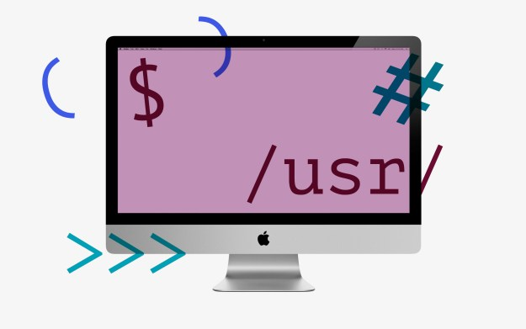



Write logic: parse knowledgeC.db and transform to Hansken types
knowledgeC.db
Python script
traces of type “event”

Slide 16
Talking points for today
(3 min) Our fictional case…
(2 min) Extract knowledgeC.db in Hansken
(3 min) Extraction plugin concepts
(5 min) Write logic: parse knowledgeC.db and transform to Hansken types
(5 min) Extraction plugin template
(5 min) Add logic to plugin
(5 min) Run with Hansken.py
(5 min) Run the plugin during an extraction
(3 min) Add tests to our code
(3 min) Wrap up and questions

Slide 17
Extraction plugin template
Steps
Clone an template plugin from Github
Build the template plugin
(Upload the plugin to Hansken)
Refresh the plugin list in Hansken

Slide 18
Talking points for today
(3 min) Our fictional case…
(2 min) Extract knowledgeC.db in Hansken
(3 min) Extraction plugin concepts
(5 min) Write logic: parse knowledgeC.db and transform to Hansken types
(5 min) Extraction plugin template
(5 min) Add logic to plugin
(5 min) Run with Hansken.py
(5 min) Run the plugin during an extraction
(3 min) Add tests to our code
(3 min) Wrap up and questions

Slide 19
Add logic to plugin
Steps
Update plugin info
Naming convention
Matcher (common PITA)
Plugin resources (common PITA2)
Implement process method

Slide 20
Talking points for today
(3 min) Our fictional case…
(2 min) Extract knowledgeC.db in Hansken
(3 min) Extraction plugin concepts
(5 min) Write logic: parse knowledgeC.db and transform to Hansken types
(5 min) Extraction plugin template
(5 min) Add logic to plugin
(5 min) Run with Hansken.py
(5 min) Run the plugin during an extraction
(3 min) Add tests to our code
(3 min) Wrap up and questions

Slide 21

Run plugin with Hansken.py
Steps
Run plugin from the IDE:
Determine program arguments (projectId, URLs)
Define run profile
Run!
Verify results

Slide 22
Talking points for today
(3 min) Our fictional case…
(2 min) Extract knowledgeC.db in Hansken
(3 min) Extraction plugin concepts
(5 min) Write logic: parse knowledgeC.db and transform to Hansken types
(5 min) Extraction plugin template
(5 min) Add logic to plugin
(5 min) Run with Hansken.py
(5 min) Run the plugin during an extraction
(3 min) Add tests to our code
(3 min) Wrap up and questions

Slide 23
Run the plugin during an extraction
Steps
Package the plugin (tox –e package)
Refresh plugin list in Hansken
Run an extraction
Inspect results
Inspect chain of evidence

Slide 24
Talking points for today
(3 min) Our fictional case…
(2 min) Extract knowledgeC.db in Hansken
(3 min) Extraction plugin concepts
(5 min) Write logic: parse knowledgeC.db and transform to Hansken types
(5 min) Extraction plugin template
(5 min) Add logic to plugin
(5 min) Run with Hansken.py
(5 min) Run the plugin during an extraction
(3 min) Add tests to our code
(3 min) Wrap up and questions

Slide 25
Add tests to our code
Steps
Why?
Have a look at the documentation on GitHub
Add test data to plugin
Generate & verify baseline resuts

Slide 26
Talking points for today
(3 min) Our fictional case…
(2 min) Extract knowledgeC.db in Hansken
(3 min) Extraction plugin concepts
(5 min) Write logic: parse knowledgeC.db and transform to Hansken types
(5 min) Extraction plugin template
(5 min) Add logic to plugin
(5 min) Run with Hansken.py
(5 min) Run the plugin during an extraction
(3 min) Add tests to our code
(3 min) Wrap up and questions

Slide 27
Wrap up
We learned:
What extractions plugins are, how they relate to Hansken.py use cases
Where to find plugins created by other community members
How to create, test, and run a new plugin by downloading a plugin template and add an actual implementation
A note on extraction plugins in practice:
Starting to prove itself in action
Technology preview please report bugs, and share your experience!
Debugging can be difficult -> “why does my plugin not work”?
Needs to grow!

Slide 28
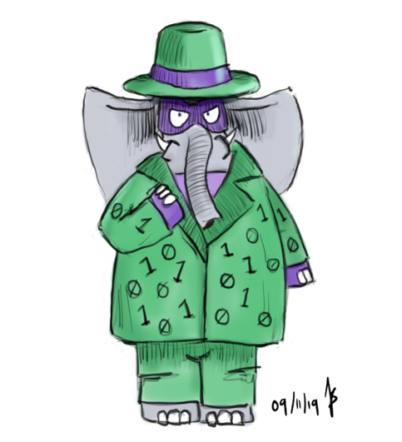
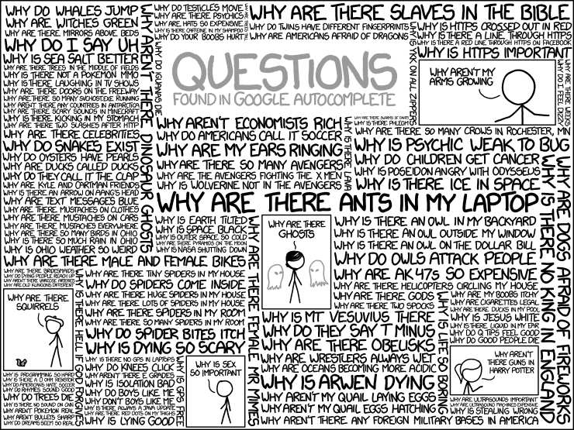
Thank you for your attention

Slide 29
Thank you for your attention

